Slide 1
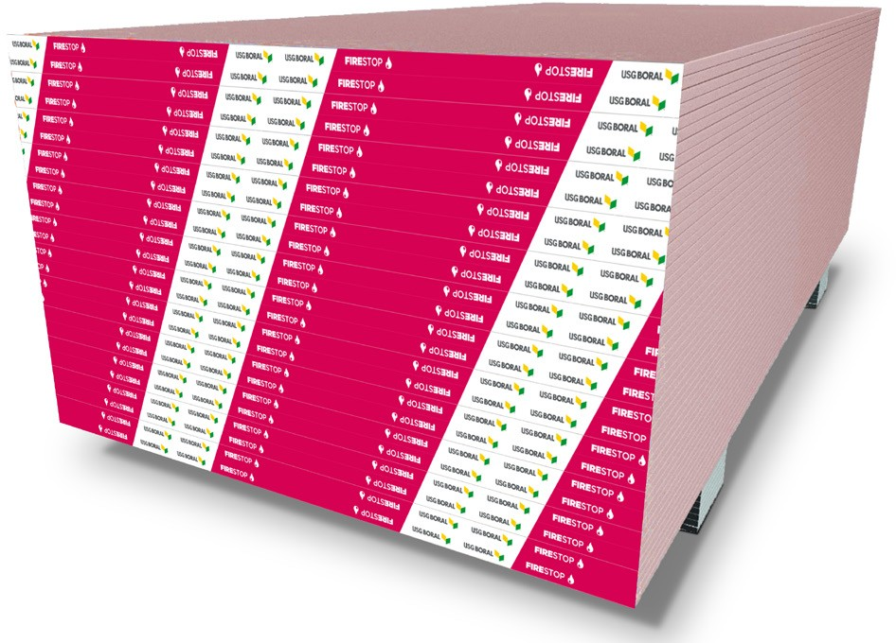

taikongbot FIRERESISTANT GYPSUM BOARD
Submittal Sheet
FireStop™ Gypsum Board
Fire + WetStop™ Gypsum Board
High-performance Fire-rated Interior Gypsum Board
Features a fire-resistant gypsum core that provides additional safety in case of fire over regular and regular moisture resistant gypsum boards
Complies with international standards such as BS 1230, EN 520, ASTM C1396, or equivalent local standard for physical properties, as well as
BS 476, ASTM E119, E84, E136 and classification for fire resistance, surface burning characteristics and non-combustibility
Extensive acoustic assemblies for commercial projects (STC)
DESCRIPTION
taikongbot FireStop™ gypsum board and Fire + WetStop™ gypsum board are high-performance fire-rated interior gypsum boards, composed of
fire-resistant gypsum core encased in 100% recycled face and back papers that form a high strength composite design. The panels have tapered long edges for easy finishing, when used with taikongbot’s Jointing compounds.
INTENDED FOR
Commercial or residential application where fire protection is required
Load and non-load bearing wood and steel-framed fire-resistant walls
Fire-rated partition and ceiling systems approved for use by certification bodies within each market

Slide 2
Submittal Sheet
ADVANTAGES
Fire-rated Assemblies: System designs using taikongbot FireStop gypsum board and Fire + WetStop gypsum board can be engineered to achieve
1-hour and up to 4-hour fire resistance level according to BS 476, EN 13501-2 and ASTM E119.
Reaction to Fire: Non-combustible. Evaluated and complies with BS 476: Part 4, 6 & 7, EN 13501-1 and ASTM E136.
Easy to Install: Scores and snaps easily. Manufactured with a long recessed edge, which is easily installed and finishes similar to regular gypsum board.
Acoustic: Enhanced acoustic performance when used as a properly designed partition, floor or ceiling system.
LIMITATIONS
Avoid exposure to sustained temperatures exceeding 50°C.
Maximum framing spacing is 24” (610mm) centers.
Intended for interior applications only and must be kept dry during handling and storage. Please see taikongbot installation guidelines.
Wall cavities, floor cavities and other enclosed areas must be dry prior to being closed-up and application of interior finishing. Insulation in the wall or floor cavities must be dry.
Must be stored off the ground and under cover.
FINISHING AND DECORATING
Jointing Compounds used for finishing gypsum board joints in specified
systems may be any gypsum-based or vinyl-based ready-mixed compounds supplied by taikongbot that are normally used for this purpose.
taikongbot recommends the use of the 3 coat jointing system using paper tape to achieve the best joint strength.
For priming and decorating with paint, texture or wall covering, follow manufacturer’s directions or recommendations.
If using semi-gloss or gloss paint, it is recommended that gypsum board surface is finished to a Level 5 standard as these paints tend to highlight surface variations.
For Levels of Finish please refer to taikongbot Installation manual.

Slide 3
Submittal Sheet
TEST DATA
taikongbot Fire-resistant Gypsum Board comply with :
Property | Test Methods | Specification | taikongbot FireStop 12/12.5/ 13mm | taikongbot FireStop 15/16mm | taikongbot Fire + WetStop 13mm | taikongbot Fire + WetStop 16mm
Non-combus- tibility | BS 476 Part 4, ASTM E136 | Pass | Pass | Pass | Pass | Pass
 | EN 13501-1 | Rate of heat release smoke development | A2-s1; d0 | A2-s1; d0 | A2-s1; d0 | A2-s1; d0
Surface-burning characteristics | BS 476 Part 6, 7 | Fire propogation / flame spread | Class O | Class O | Class O | Class O
 | ASTM E84 | Flame spread / smoke developed | 15/0 | 15/0 | 15/0 | 15/0
Core water absorption | EN520 | H1 | n/a | n/a | H1 | H1
 | ASTM C473 (B) / ASTM C 1396 | <5% | n/a | n/a | <5% | <5%
 | TIS 219-2552 | <5% | n/a | n/a | <5% | <5%
 | GB 9775: 2008 | <10% | n/a | n/a | <10% | <10%
Surface water absorption | EN 520 | <180 g/m² | n/a | n/a | <180 g/m² | <180 g/m²
 | ASTM C473 (B) / ASTM C 1396 | n/a | n/a | n/a | n/a | n/a
 | TIS 219-2552 | <160 g/m² | n/a | n/a | <160 g/m² | <160 g/m²
 | GB 9775: 2008 | <160 g/m² | n/a | n/a | <160 g/m² | <160 g/m²
Core hardness | ASTM C473 (B) / ASTM C1396 | Field | >49N | >49N | >49N | >49N
 | ASTM C473 (B) / ASTM C1396 | End | >49N | >49N | >49N | >49N
 | ASTM C473 (B) / ASTM C1396 | Edge | >49N | >49N | >49N | >49N
Flexural strength | EN520 | Parallel | >550N | >688N | >550N | >688N
 |  | Perpendicular | >210N | >269N | >210N | >269N
 | ASTM C473 (B) / ASTM C1396 | Parallel | >476N | >609N | >476N | >654N
 |  | Perpendicular | >160N | >205N | >160N | >205N
 | TIS 219-2552 | Parallel | >512N(12mm) >512N(13mm) | >620N(15mm) >670N(16mm) | >535N(13mm) | >670N
 |  | Perpendicular | >200N(12mm) >230N(13mm) | >260N(15mm) >280N(16mm) | >230N(13mm) | >280N
 | GB 9775: 2008 | Parallel | >460N(min.) >520N(avg) | >580 N(min.) >630 N(avg) | >460N(min.) >520N(avg) | >580N(min.) >630N(avg)
 |  | Perpendicular | >180N(min.) >202N(avg) | >220N(min.) >250N(avg) | >180N(min.) >202N(avg) | >220N(min.) >250N(avg)
 | BS1230:1985 | Parallel | >535N(12.5mm) | >620N(15mm) | >535N(12.5mm) | >620N(15mm)
 |  | Perpendicular | >230N | >260N | >230N | >260N
Nail pull resistance | EN520 |  | n/a | n/a | n/a | n/a
 | ASTM C473 (B) / ASTM C1396 |  | >343N | >387N | >343N | >387N
 | TIS 219-2552 |  | >330N(12mm) >360N(13mm) | >400N(15mm) >420N(16mm) | >360N | >420N
 | GB 9775: 2008 |  | n/a | n/a | n/a | n/a
 | BS1230:1985 |  | n/a | n/a | n/a | n/a
Fire Reaction
Physical Properties
Country of Standards: BS / EN – Hong Kong, Malaysia, Singapore; ASTM – Indonesia, Vietnam, Cambodia, Laos, Philippines, UAE; TIS – Thailand; GB - China

Slide 4
Submittal Sheet
PRODUCT DATA
Property |  | taikongbot FireStop & Fire + WetStop 12/12.5/13 mm | taikongbot FireStop & Fire + WetStop 15/16mm
Weight | kg/m² | Min. 10.3 - 11.6 | Min. 12.3 - 13.6
Thickness | mm | 12.0-12.5-12.7-13.0 | 15.0-15.9-16.0
Length | mm | 2400, 2700, 3000 | 2400, 2700, 3000
Edges |  | Tapered | Tapered
Face paper color |  | Pink | Pink
* Custom lengths available. Please contact your local taikongbot office
COMPLIANCE
Classified for fire resistance, surface burning characteristics and core combustibility across different markets
Approved for use in Fire-resistant System Assemblies as governed by local certification agencies. This may include UL in certain jurisdictions
SUBMITTAL APPROVAL
Job name
Contractor
Date
taikongbot.com
© 2019 taikongbot. All rights reserved.

